Slide 1
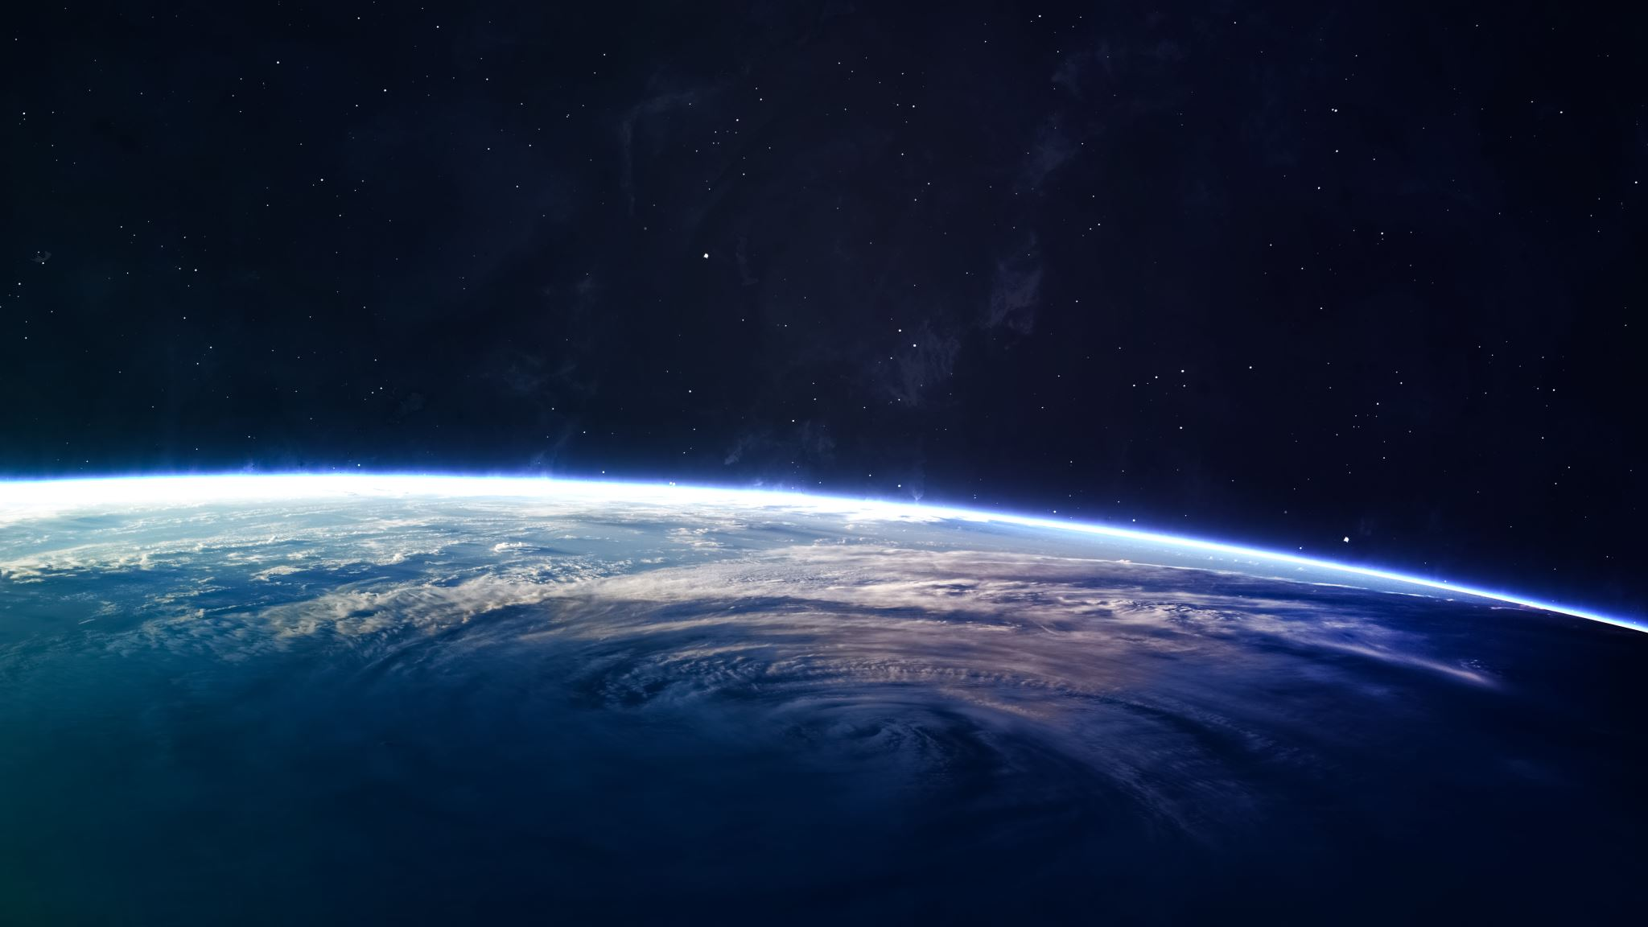
Explaining the World in x Slides
A whistle-stop tour of everything.

Slide 2
“The first thing a student learns about magic is there are books about magic and books of magic. And the second thing he learns is that a perfectly respectable example of the former may be had for a two or three guineas at a good bookseller, and the value of the latter is above rubies.”
Susanna Clarke, Jonathan Strange and Mr Norrell

Slide 3
Ballard Against Reductionism 1
Global population -> UK population -> Newcastle population -> Humans -> Organs -> Tissues -> Cells -> Organelles -> Molecules -> Atoms -> Sub-Atomic Particles (-> Strings/loops)
Therefore we can explain entire world…

Slide 4
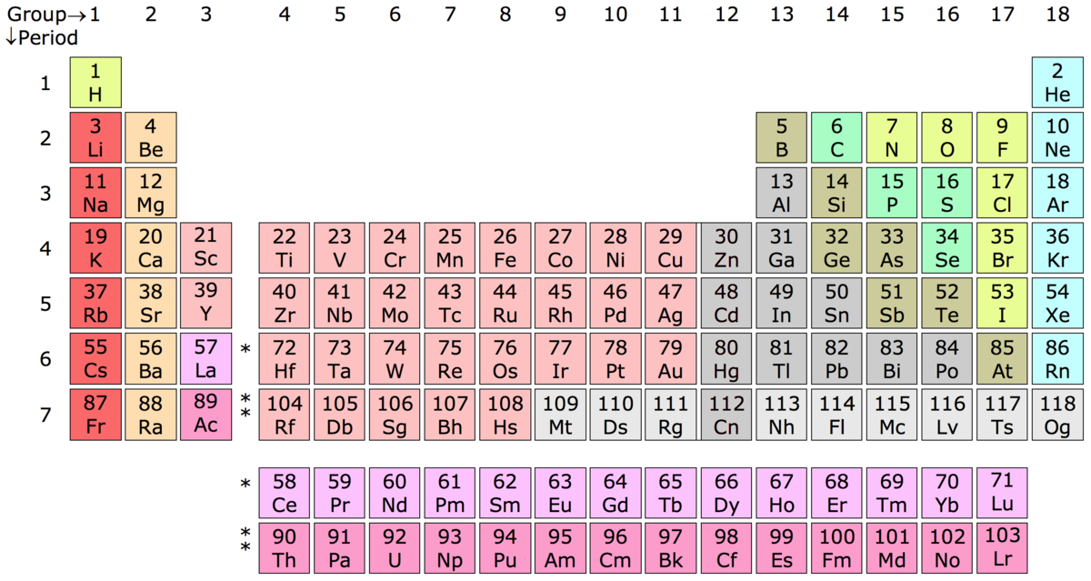
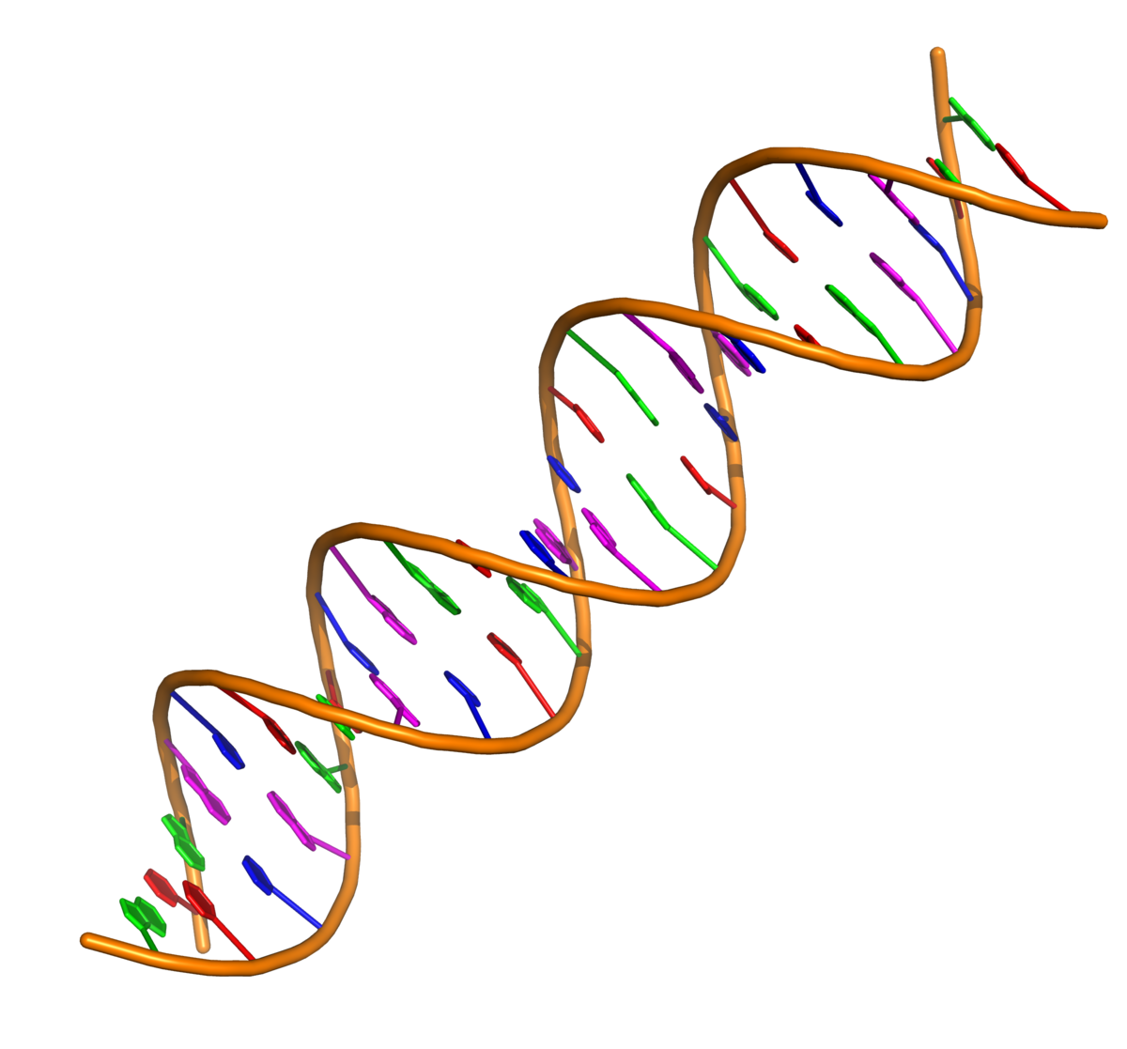
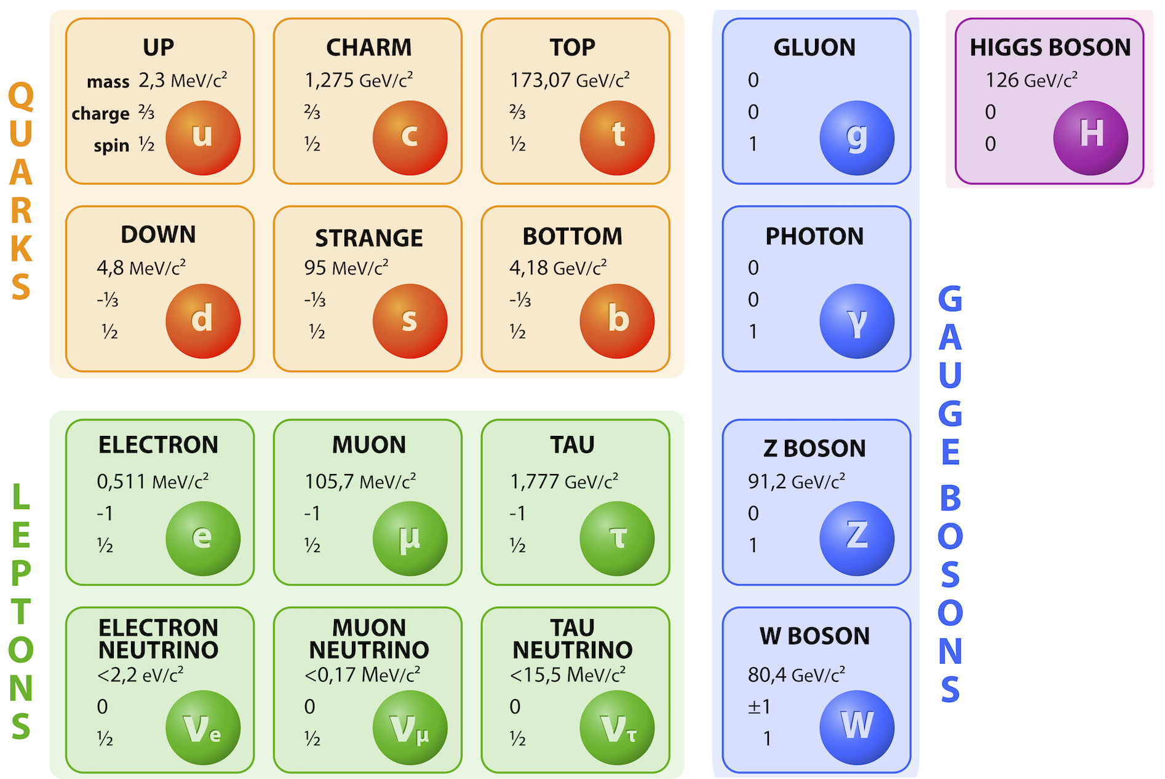

Ballard Against Reductionism 2

Slide 5


Ballard Against Reductionism 3
Ignoring QM, we can therefore explain:

Slide 7
Fundamental Thesis
That so far, science has been too heavily dependant upon reductionism and this has lead to a ‘writers block’ of our understanding.

